Slide 1



AIMDA26_053
International Conference on Artificial Intelligence in Multidisciplinary Applications
gapHQ, Colombo, Sri Lanka
13th - 14th February 2026
HYBRID DEEP LEARNING MODELS FOR TIME SERIES
FORECASTING OF USER ENGAGEMENT IN PYTHON
SOFTWARE APPLICATIONS
Presented By : V Janarthan Affiliation : Department of Software Engineering, Faculty of Computing, Sabaragamuwa
University of Sri Lanka Country : Sri Lanka
Authors: V Janarthan*, JDT Erandi, YMS Tharaka, M Vasavan, K Luxshi

Slide 2
AIMDA26_053
Background & Motivation
User engagement is critical for usability, adoption, and planning.
Python applications generate rich usage logs:
DAU, sessions, downloads, feature usage, errors
Existing analytics:
Focus on past trends
Dominated by statistical methods
Most research targets social media platforms.
Python software applications are rarely considered.
1

Slide 3
AIMDA26_053
Research Gap & Problem
Existing studies focus on social media platforms, not Python-based applications.
Current models fail with irregular, sparse, and bursty usage logs.
Statistical models miss nonlinear patterns; deep learning needs large data & resources.
Lack of hybrid, domain-specific forecasting frameworks for Python software.
Need for an accurate and interpretable engagement forecasting model for Python applications.
2

Slide 4
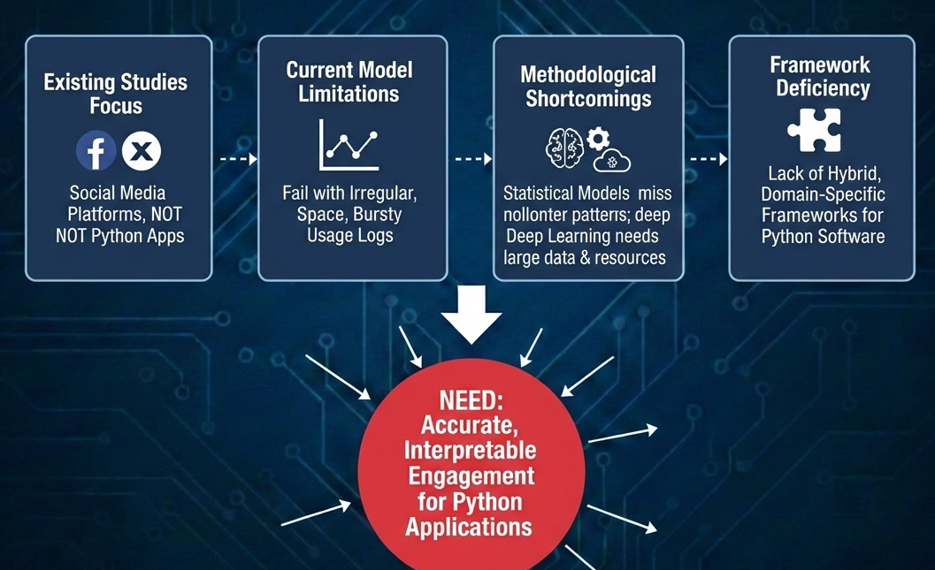
AIMDA26_053
Research Gap & Problem Cont.…
Figure 1: Research Gap & Problem (Gemini)
3

Slide 5
AIMDA26_053
Research Objectives
Evaluate statistical forecasting models (ARIMA, SARIMA, Prophet) on Python usage logs.
Analyze deep learning models (LSTM, GRU) for nonlinear and irregular engagement patterns.
Develop and assess hybrid models (Prophet–LSTM, SARIMAX–GRU) for improved accuracy.
Incorporate contextual factors (version releases, feature updates, calendar effects).
Build a Python-based forecasting tool for practical user engagement prediction.
4

Slide 6
AIMDA26_053
Research Question and Objectives mapping
Table 1 : Research Question and Objectives mapping
Research Question (RQ) | Corresponding Research Objective (RO)
RQ1: How accurately do statistical models forecast engagement in Python applications? | RO1: Evaluate statistical models (ARIMA, SARIMA, Prophet) on Python usage logs
RQ2: Do deep learning models outperform traditional models under sparse and bursty conditions? | RO2: Analyze deep learning models (LSTM, GRU) for nonlinear engagement patterns
RQ3: Can hybrid models better capture both seasonal and nonlinear trends? | RO3: Develop and evaluate hybrid models (Prophet–LSTM, SARIMAX–GRU)
RQ4: How do contextual factors affect engagement forecasting accuracy? | RO4: Integrate contextual features (releases, updates, calendar effects)
RQ5: Can forecasting models be deployed as a practical tool for developers? | RO5: Build a Python-based engagement forecasting tool
5

Slide 7
AIMDA26_053
Dataset & Features
Dataset
Source: Python application usage logs (Kaggle repositories)
Records: 18,479 daily observations
Time span: May 2015 – September 2024
Granularity: Daily time-series (per application per date)
Target Variable: Daily Active Users (DAU)
Features
Engagement: Session Count, Average Session Duration
Interaction: Likes, Shares, Comments, Downloads
System: Error Count
Temporal: Day of Week, Month, Weekend Flag
Contextual: Release / Version Update Flag
6

Slide 8
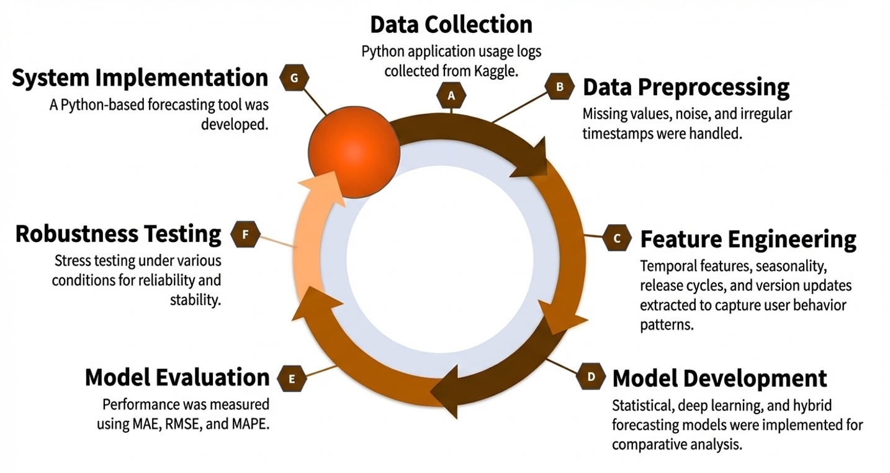
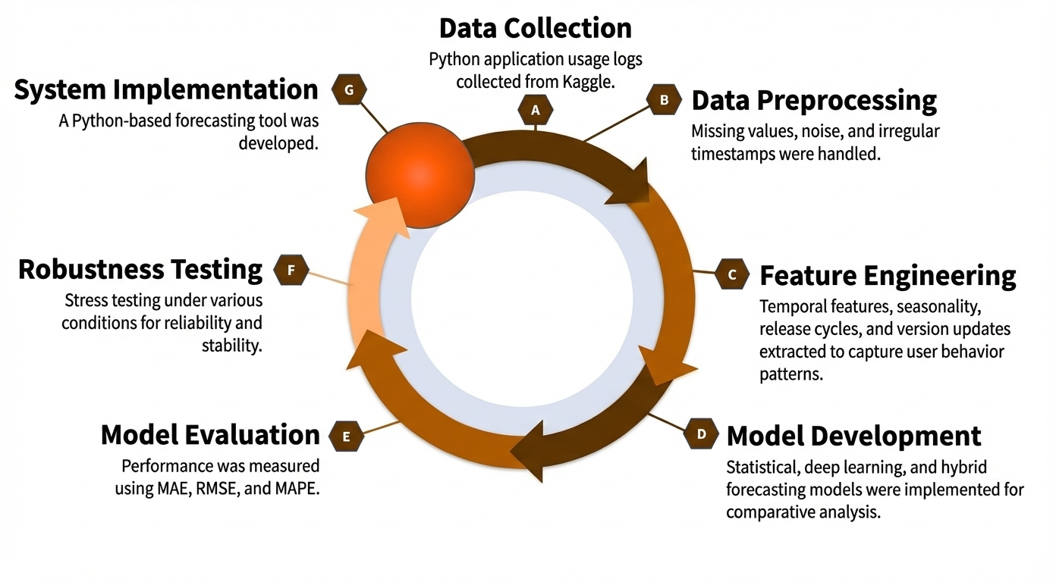
AIMDA26_053
Methodology Overview
Figure 2: Methodology Diagram
7

Slide 9
AIMDA26_053
Methodology Overview Cont.…
Data Collection: Python application usage logs collected from Kaggle repositories.
Data Preprocessing: Cleaning, handling missing values, outlier control, and daily time-series aggregation.
Feature Engineering: Extraction of engagement, interaction, system, temporal, and release-based features.
Model Development:
Statistical models: ARIMA, SARIMA, Prophet
Deep learning models: LSTM, GRU
Hybrid models: SARIMAX–GRU, Prophet–LSTM
8

Slide 10
AIMDA26_053
Methodology Overview Cont.…
Model Evaluation: Performance measured using MAE, RMSE, and MAPE with chronological validation and Wilcoxon signed-rank test.
Robustness Testing: Evaluation under normal, sparse, and bursty usage patterns, Chronological Split, Scenario-Based Testing and 28-Day Forecast Horizon.
Tool Development: Python-based forecasting tool using Django, React, TensorFlow, and REST API.
“This pipeline ensures robustness and practical applicability for real-world Python software usage.”
9

Slide 11
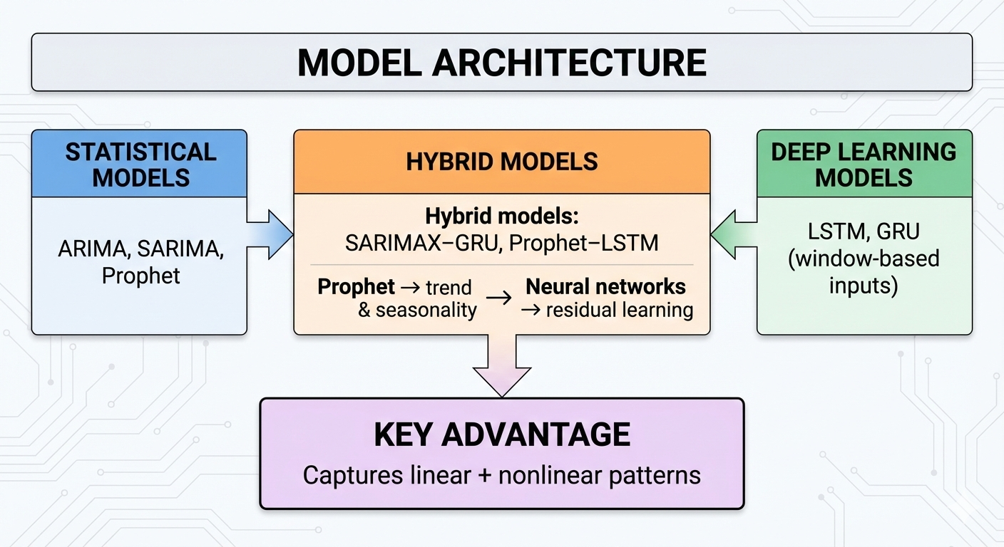
AIMDA26_053
Methodology Overview Cont.…
Figure 3: Models Architecture
10

Slide 12
AIMDA26_053
Results & Discussion
Statistical Models: ARIMA performed best among traditional models (MAPE: 12.34%) but struggled with nonlinear spikes caused by releases and updates.
Deep Learning Models: LSTM (34.90%) and GRU (32.96%) captured long-term patterns but underperformed in sparse and bursty scenarios due to overfitting and data limitations.
Hybrid Models (Best Results):
Prophet–LSTM: MAPE = 6.35% (best overall)
SARIMAX–GRU: MAPE = 8.53%
These models effectively combined seasonality extraction and nonlinear residual learning, leading to robust forecasts.
11

Slide 13
AIMDA26_053
Results & Discussion Cont...
Impact of Contextual Features:
Incorporating release flags and calendar effects significantly improved prediction accuracy, especially during bursty usage periods.
Statistical Significance:
Performance gains of Prophet–LSTM over SARIMAX–GRU were statistically validated (p = 3.67 × 10⁻⁶).
12

Slide 14
AIMDA26_053
Results & Discussion Cont...
Table 2. Final model performance summary
Model | Prophet-LSTM | SARIMAX-GRU | ARIMA | Prophet-ElasticNet | GRU | LSTM | Prophet | SARIMA
Type | Hybrid | Hybrid | Statistical | Hybrid | Deep | Deep | Statistical | Statistical
MAE | 192.66 | 236.68 | 226.32 | 1792.44 | 349.30 | 420.08 | 474.53 | 686.79
RMSE | 281.42 | 298.63 | 318.04 | 3292.89 | 478.13 | 623.47 | 888.11 | 873.89
MAPE | 6.35% | 8.53% | 12.34% | 18.68% | 32.96% | 34.90% | 37.40% | 47.84%
13

Slide 15
AIMDA26_053
Results & Discussion - Forecasting Tool
Purpose: Practical prediction of future user engagement in Python-based applications.
Architecture: Python-based web application with RESTful design.
Tech Stack: Django (Backend), React + Vite (Frontend), TensorFlow, Prophet
Models Integrated: Prophet–LSTM and SARIMAX–GRU (best-performing hybrids).
Functionality:
Upload Python application usage logs (CSV).
Run forecasting models automatically.
Visualize forecasts using interactive graphs and tables.
Validation: Tested under normal, sparse, and bursty usage scenarios.
Outcome: Enables data-driven engagement planning for developers and product teams.
14

Slide 16
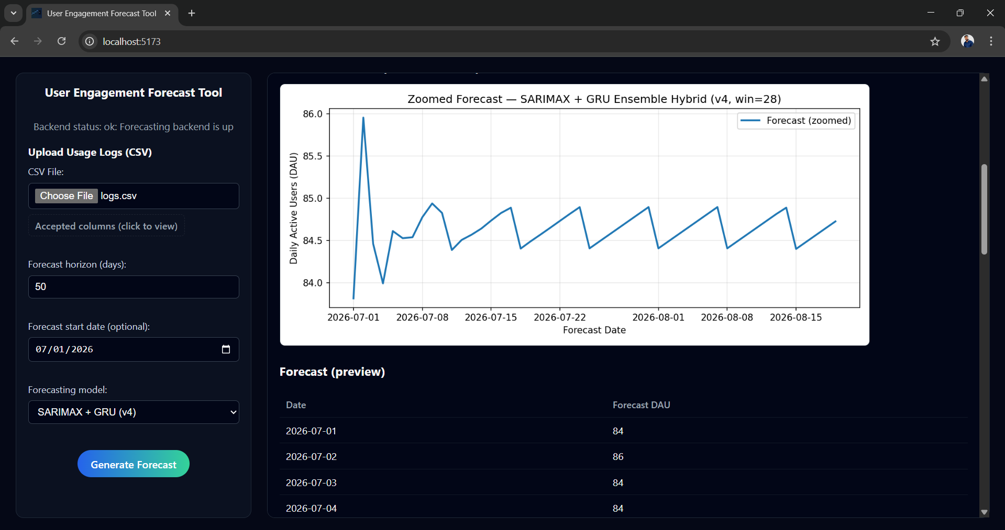
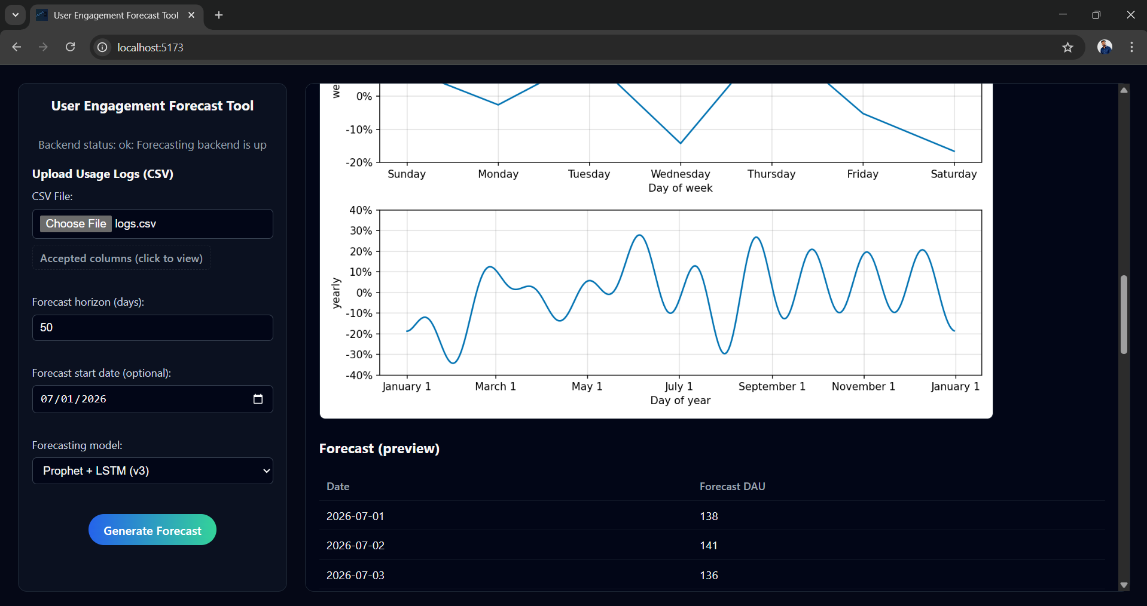
AIMDA26_053
Results & Discussion - Forecasting Tool
Figure 4. Daily Active Users forecasting using
the SARIMAX–GRU hybrid model.
Figure 5. Daily Active Users forecasting using
the Prophet–LSTM hybrid model.
15

Slide 17
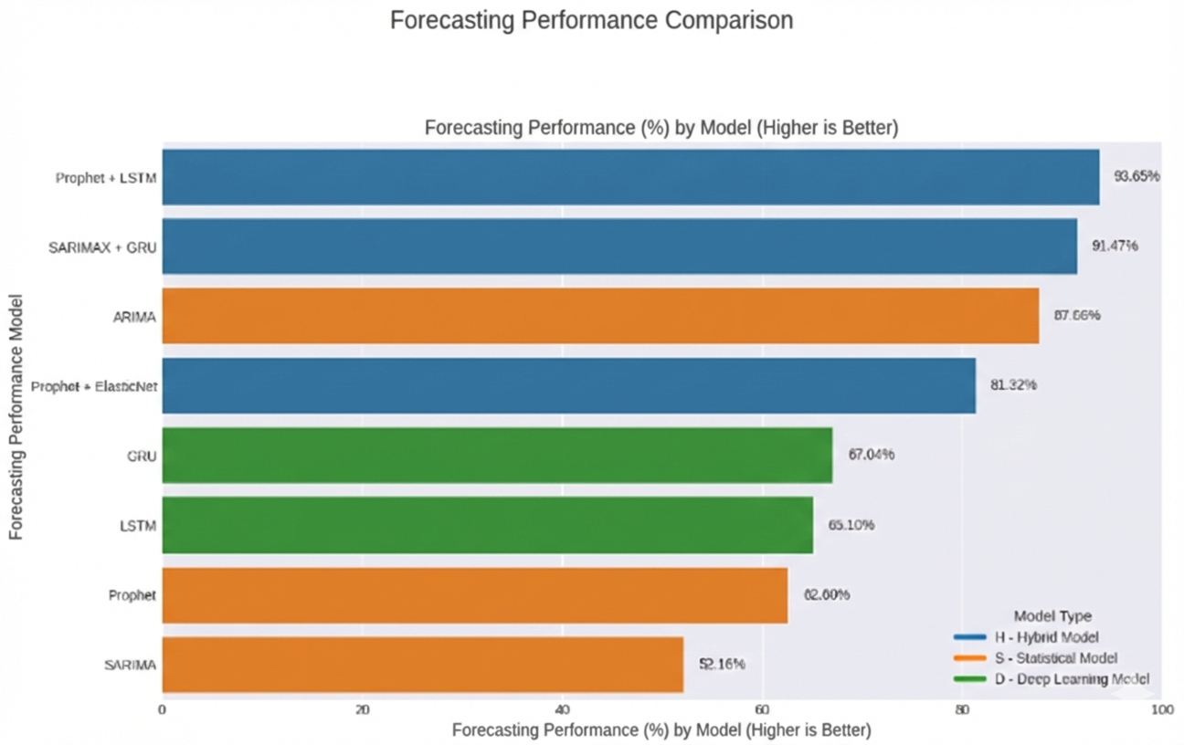
AIMDA26_053
Results & Discussion Cont...
Figure 6. Models Forecasting Performance (100 - MAPE)%
16

Slide 18
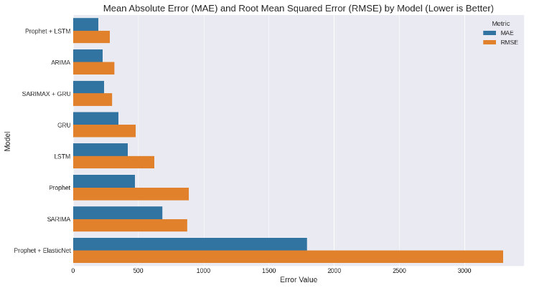
AIMDA26_053
Results & Discussion Cont...
Figure 7. Models Evaluation Comparison (MAE and RMSE)
17

Slide 19
AIMDA26_053
Conclusion & Future Work
Conclusion
Hybrid forecasting models significantly outperform statistical and deep learning approaches for Python application engagement prediction
Prophet–LSTM achieved the best performance (MAPE: 6.35%), showing robustness under sparse and bursty usage patterns
Contextual features (release cycles, calendar effects) play a critical role in improving forecasting accuracy
The proposed Python-based forecasting tool demonstrates real-world applicability for developers and product teams
18

Slide 20
AIMDA26_053
Conclusion & Future Work
Future Work
Extend the study using industrial-scale Python application logs.
Incorporate additional contextual variables (e.g., marketing events, outages, demographics).
Enable real-time forecasting and automated model retraining.
Explore explainable AI techniques to improve model interpretability.
19

Slide 21
AIMDA26_053
References
Y. H. Kong, K. Y. Lim, and W. Y. Chin, “Time series forecasting using a hybrid Prophet and long short-term memory model,” in Soft Computing in Data Science, Singapore: Springer, 2021, pp. 183–196.
Y. Liu, X. Shi, L. Pierce, and X. Ren, “Characterizing and forecasting user engagement with in-app action graph: A case study of Snapchat,” in Proc. 25th ACM SIGKDD Int. Conf. Knowledge Discovery & Data Mining, Anchorage, AK, USA, 2019, pp. 2023–2031.
R. J. Hyndman and G. Athanasopoulos, Forecasting: Principles and Practice, 2nd ed. Melbourne, Australia: OTexts, 2018.
G. P. Zhang, “Time series forecasting using a hybrid ARIMA and neural network model,” Neurocomputing, vol. 50, pp. 159–175, 2003.
X. Liu and W. Wang, “Deep time series forecasting models: A comprehensive survey,” Mathematics, vol. 12, no. 4, 2024.
H. Gnanasekaran, D. P., and U. Köse, “Time-series forecasting of web traffic using Prophet machine learning model,” J. Artificial Intelligence & Systems, vol. 1, pp. 161–177, 2023.
19

Slide 22

AIMDA26_053
International Conference on Artificial Intelligence in Multidisciplinary Applications
gapHQ, Colombo, Sri Lanka
13th - 14th February 2026

